Slide 1
Intelligent Job Match
Team Details:
Kodumuri Likhitha(20EG105225)
S. Nikhila Reddy(20EG105245)
Dutta Saurabh(20EG10512)
Project Supervisor
Name: Mr. V. RamaKrishna
Designation: Assistant Professor

Slide 2
Introduction
Intelligent Job Match is a cutting-edge project harnessing the power of Natural Language Processing (NLP) to revolutionize the recruitment process. By meticulously analyzing resumes, this innovative tool assigns scores to each role, determining the suitability of candidates based on a comprehensive evaluation of their skills and experiences. Employing advanced NLP algorithms, the system identifies keywords within resumes and intelligently clusters them into sectors, providing a holistic view of an individual's expertise. Going beyond traditional resume parsing, the tool not only offers an overall score but also delivers targeted recommendations, predictions, and analytics. For both applicants and recruiters, this technology acts as a guiding force, offering insights into missing skills and providing valuable tips to enhance the quality of resumes. In the realm of talent acquisition, Intelligent Job Match stands at the forefront, streamlining the hiring process and fostering better-informed decisions.

Slide 3
Problem Statement
The traditional resume screening process is inefficient, time-consuming, and prone to human error. Recruiters struggle to manually review and assess the vast number of resumes they receive, often overlooking qualified candidates due to keyword biases or inconsistencies in formatting. This leads to missed opportunities for both employers and potential employees. To address this issue, we are introducing an intelligent resume screening system that leverages natural language processing to streamline and enhance the recruitment process, providing an efficient and unbiased evaluation of candidates.

Slide 4
Proposed Method
Data Collection and Processing: Our system will curate a diverse dataset of resumes, encompassing various roles and industries, to ensure comprehensive coverage. The dataset will include different formats and styles of resumes.
Natural Language Processing (NLP): Employing advanced NLP techniques, the system will analyze resumes to extract keywords, cluster them based on relevant sectors, and identify key skills and qualifications.
Model Training: Using state-of-the-art machine learning frameworks such as Thinc and spacy, our model will be trained on the curated dataset to assign scores for each role, provide resume tips, and generate an overall score for applicants.
Real-time Recommendation System: Once trained, the system will seamlessly integrate into a real-time job matching platform. It will assess resumes, match them to suitable roles, and offer intelligent recommendations, predictions, and analytics for both applicants and recruiters.

Slide 5
Proposed Method
User uploads
resume
Resume analysis
User views the skills recommended
Links for required courses displayed
Interview preparation videos
Tips for better resume building
View resume score

Slide 6
Experiment Environment
Operating System: Windows
IDE: PyCharm, Jupyter Notebook, VS Code
Libraries: spaCy, NLTK, pandas, scikit-learn, Streamlit
Resume Parsing: I have experience in developing resume parsing applications using Python, specifically leveraging libraries such as spaCy and NLTK for natural language processing tasks. By utilizing these tools, I have built systems capable of extracting key information from resumes such as contact details, skills, work experience, education, and certifications, which are crucial for automated resume screening and analysis.
Ranking Algorithms: I am proficient in implementing various ranking algorithms using Python and relevant libraries such as pandas and scikit-learn. I have applied algorithms like TF-IDF (Term Frequency-Inverse Document Frequency), cosine similarity, and clustering techniques to analyze and rank resumes based on job requirements, skill matches, and relevancy scores. These algorithms help in identifying the most suitable candidates for specific job roles, optimizing the recruitment process, and improving candidate shortlisting efficiency.
Programming Languages: Python 3.10

Slide 7
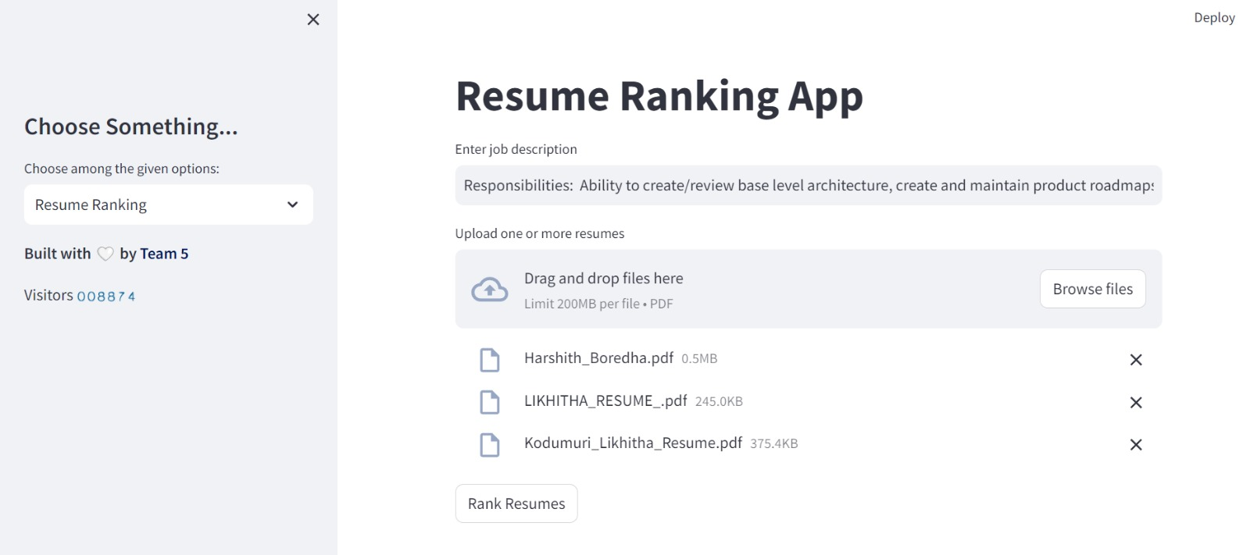
Experiment Screen shorts

Slide 8
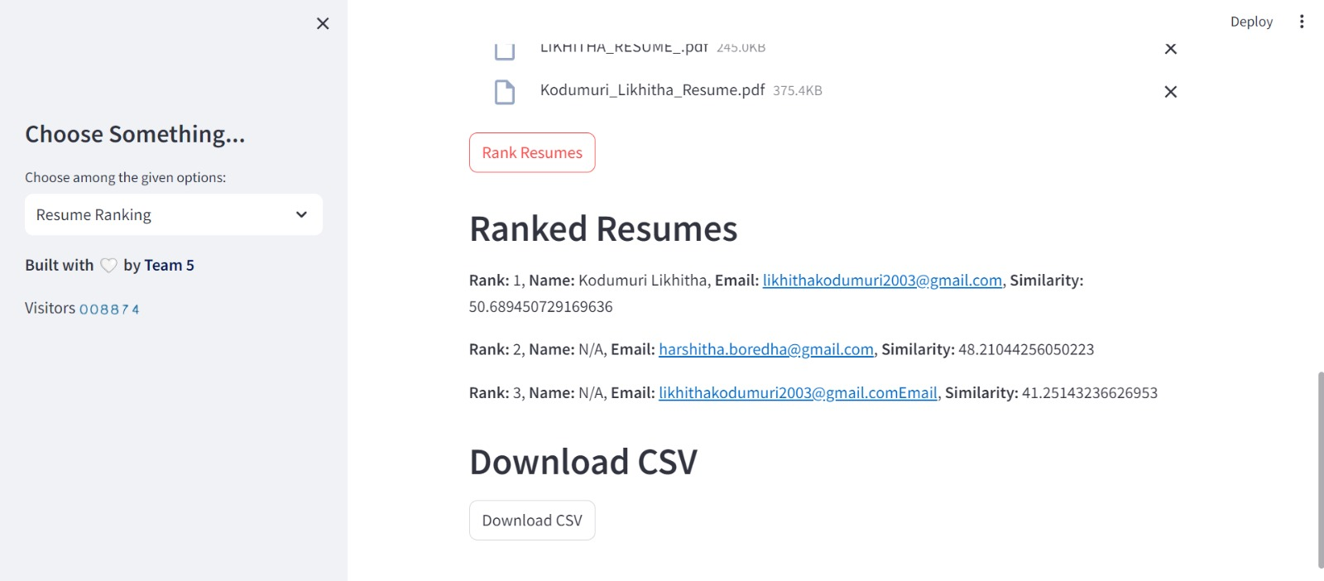
Experiment Screen shorts

Slide 9
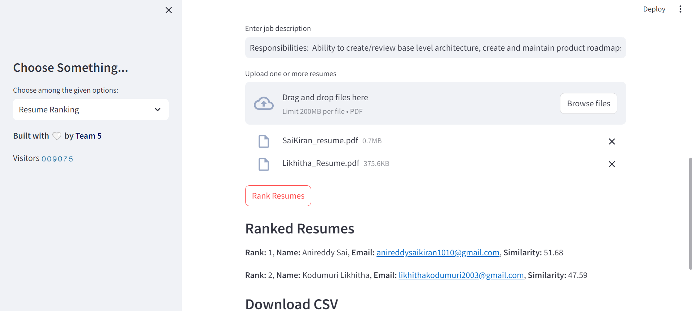
Experiment Screen shorts

Slide 10
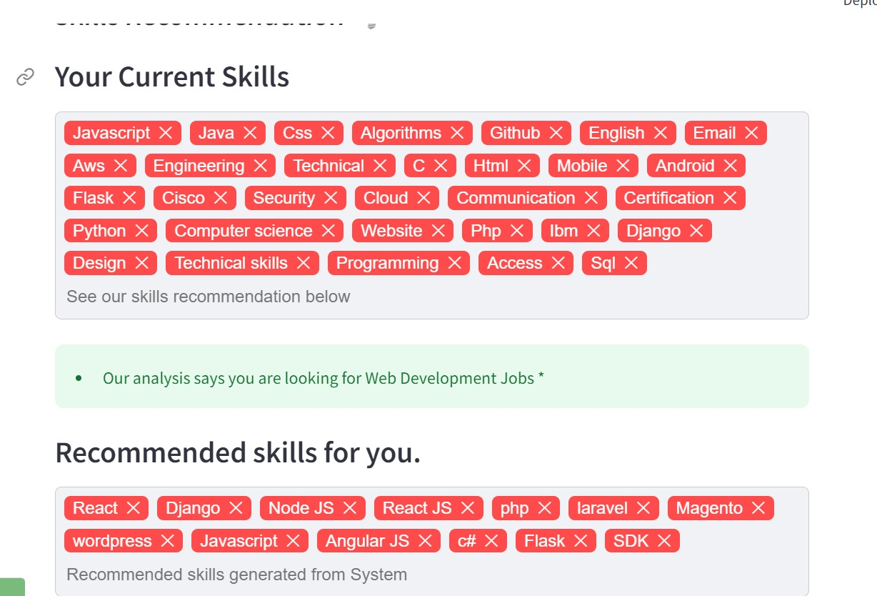
Experiment Screen shorts

Slide 11
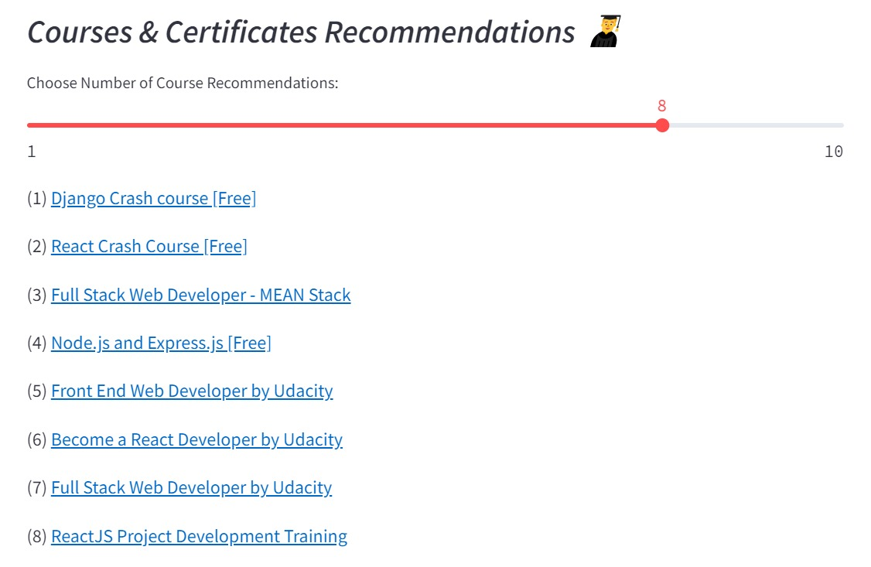
Experiment Screen shorts

Slide 12
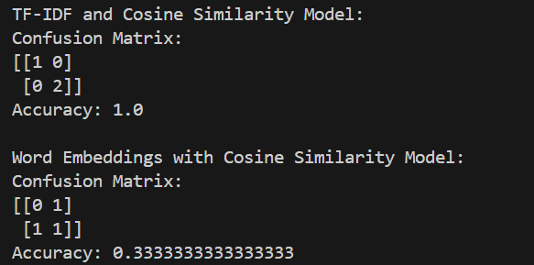
Finding

Slide 13
Justification
1.What are parameters improved by your method?
Data Understanding
Accuracy
2. why your parameter values improved?
Better Similarity Measurement:
Optimized Hyperparameters
Enhanced Feature Representation

